Slide 1


Externalize Spring Configuration

Slide 2
12 Factor Application
https://12factor.net/
In the modern era, software is commonly delivered as a service: called web apps, or software-as-a-service. The twelve-factor app is a methodology for building software-as-a-service apps that:
Use declarative formats for setup automation
Have a clean contract with the underlying operating system
Are suitable for deployment on modern cloud platforms
Minimize divergence between development and production
Can scale up without significant changes
The contributors to this document have been directly involved in the development and deployment of hundreds of apps, and indirectly witnessed the development, operation, and scaling of hundreds of thousands of apps via our work on the Heroku platform.

Slide 3
The Twelve Factors
https://12factor.net/
I. Codebase
One codebase tracked in revision control, many deploys
II. Dependencies
Explicitly declare and isolate dependencies
III. Config
Store config in the environment
IV. Backing services
Treat backing services as attached resources
V. Build, release, run
Strictly separate build and run stages
VI. Processes
Execute the app as one or more stateless processes
VII. Port binding
Export services via port binding
VIII. Concurrency
Scale out via the process model
IX. Disposability
Maximize robustness with fast startup and graceful shutdown
X. Dev/prod parity
Keep dev, stage and prod as similar as possible
XI. Logs
Treat logs as event streams
XII. Admin processes
Run admin/management tasks as one-off processes

Slide 4
III. Config
https://12factor.net/
Store config in the environment
An app’s config is everything that is likely to vary between deploys
Requires strict separation of config from code. Config varies substantially across deploys, code does not.
A litmus test for whether an app has all config correctly factored out of the code is whether the codebase could be made open source at any moment, without compromising any credentials.
Note that this definition of “config” does not include internal application config

Slide 5
Spring Environment
Environment abstraction representing the environment in which the current application is running
Models two key aspects of the application environment: profiles and properties
Properties may originate from a variety of sources: properties files, JVM system properties, system environment variables, JNDI, servlet context parameters, etc
A profile is a named, logical group of bean definitions to be registered with the container only if the given profile is active

Slide 6
@PropertySource
Provides mechanism for adding a PropertySource to Spring's Environment.
In cases where a given property key exists in more than one property resource file, the last processed source will 'win' and override any previous key with the same name
The override ordering depends on the order in which these source are registered with the application context

Slide 7
@Profile
Profiles provide a way to segregate parts of your application configuration and make it be available only in certain environments
A profile may be activated programmatically or declaratively by setting the spring.profiles.active property as a JVM system property, as an environment variable SPRING_PROFILES_ACTIVE, or as a Servlet context parameter in web.xml for web applications
Profiles may also be activated declaratively in integration tests via the @ActiveProfiles annotation

Slide 8
Bootify Configs
Spring Boot lets you externalize your configuration so that you can work with the same application code in different environments
You can use a variety of external configuration sources including Java properties files, YAML files, environment variables, and command-line arguments
Spring Boot uses a very particular PropertySource order that is designed to allow sensible overriding of values. Later property sources can override the values defined in earlier ones.

Slide 9
PropertySources Order
Default properties (specified by setting SpringApplication.setDefaultProperties)
@PropertySource annotations on your @Configuration classes NB: added to Environment on application context refresh
Config data (such as application.properties files)
OS environment variables
Java System properties (System.getProperties())
JNDI attributes from java:comp/env
ServletContext init parameters
ServletConfig init parameters
Properties from SPRING_APPLICATION_JSON (inline JSON embedded in an environment variable or system property)
Command line arguments

Slide 10
JSON Application
Spring Boot allows to encode a block of properties into a single JSON structure `spring.application.json`

Slide 11
External Application Properties
Spring Boot will automatically find and load application.properties and application.yaml files from the following locations when your application starts:
From the classpath - The classpath root - The classpath /config package
From the current directory - The current directory - The config/subdirectory in the current directory - Immediate child directories of the config/ subdirectory
The list is ordered by precedence (with values from lower items overriding earlier ones)

Slide 12
Application Properties Customization
spring.config.name - switch to another file name
spring.config.location - explicit location; this property accepts a comma-separated list
spring.config.additional-location - overrides properties in the default locations
spring.config.name, spring.config.location, and spring.config.additional-location are used very early to determine which files have to be loaded. They must be defined as an environment property (typically an OS environment variable, a system property, or a command-line argument)
Use the prefix `optional:` if the locations are optional and you do not mind if they do not exist
Both directory and file location values are also expanded to check for profile-specific files

Slide 13
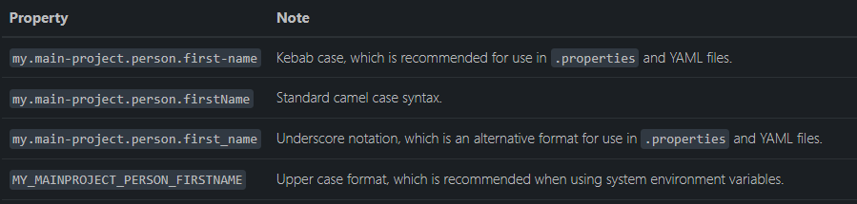
Placeholders Relaxed Binding
The values in application.properties and application.yaml are filtered through the existing Environment when they are used. Previously defined values could be used to refer back to
Relax binding:

Slide 14
Importing Additional Data
Application properties may import further config data from other locations using the spring.config.import property. Imports are processed as they are discovered, and are treated as additional documents inserted immediately below the one that declares the import
Several locations can be specified under a single spring.config.import key. Locations will be processed in the order that they are defined, with later imports taking precedence
When appropriate, profile-specific variants are also considered for import, would import both `application.properties` as well as any `application-<profile>.properties` variants
Spring Boot includes pluggable API that allows various different location addresses to be supported. By default supported: Java Properties, YAML and `configuration trees`

Slide 15
Configuration Tree
When running applications on a cloud platform (such as Kubernetes) it’s often needed to read config values that the platform supplies
As an alternative to environment variables, many cloud platforms now allow you to map configuration into mounted data volumes
There are two common volume mount patterns that can be used:
A single file contains a complete set of properties
Multiple files are written to a directory tree, with the filename becoming the ‘key’ and the contents becoming the ‘value’
For the second case, you need to use the `configtree:` prefix so that Spring Boot knows it needs to expose all the files as properties

Slide 16
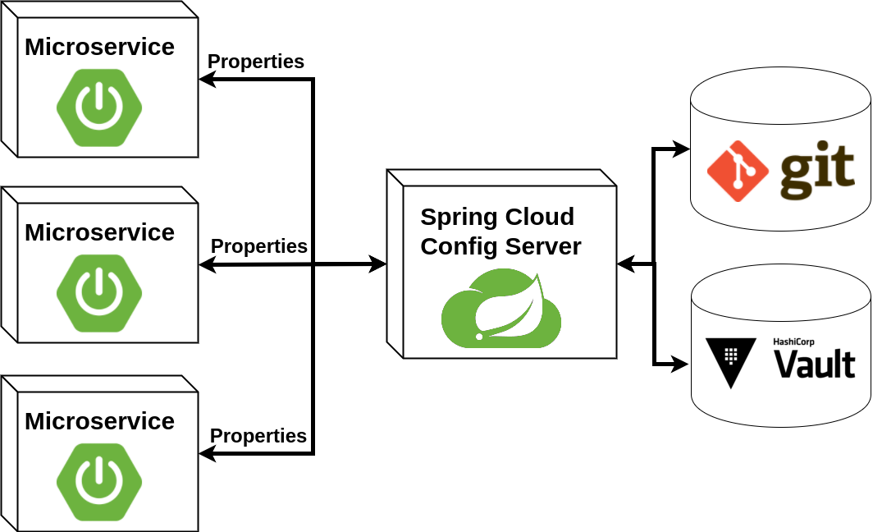
Spring Cloud Config Server
Spring Cloud Config provides server-side and client-side support for externalized configuration in a distributed system
With the Config Server, you have a central place to manage external properties for applications across all environments

Slide 17
Bootify Profiles
spring.profiles.active - used to specify which profiles are active
spring.profiles.default - used specify which profiles to use by default
spring.profiles.include - used add to the active profiles rather than replace them
NB: can only be used in non-profile specific documents
Profile Groups: A profile group allows you to define a logical name for a related group of profiles
spring.profiles.group.production[0]=proddb spring.profiles.group.production[1]=prodmq

Slide 18
Profile Specific Files
Spring Boot will also attempt to load profile-specific files using the naming convention `application-{profile}`
Profile-specific properties are loaded from the same locations as standard application.properties, with profile-specific files always overriding the non-specific ones
Properties files are only ever loaded once. If you have already directly imported a profile specific property files then it will not be imported a second time
The Environment has a set of default profiles (by default, [default]) that are used if no active profiles are set. In other words, if no profiles are explicitly activated, then properties from application-default are considered

Slide 19
Summary
Configs requires strict separation of config from code
Spring uses Environment abstraction for representing the environment in which the current application is running (profiles and properties)
Spring Boot added a lot of mechanisms to externalize configuration
Spring Boot uses a very particular PropertySource order that is designed to allow sensible overriding of values
Any property could be overriding using environment variable, JVM property or command line argument
More and more tools for externalize configs could be used via plugable API

Slide 20
References
https://12factor.net/
https://www.baeldung.com/properties-with-spring
https://docs.spring.io/spring-boot/docs/current/reference/html/features.html
https://docs.spring.io/spring-boot/docs/current/reference/html/application-properties.html
https://docs.spring.io/spring-cloud-config/docs/current/reference/html/
Cloud Native Java - Josh Long, Kenny Bastani, O'Reilly Media, ISBN ‏ : ‎ 978-1449374648
Beginning Spring Boot 3 - K. Siva Prasad Reddy, Sai Upadhyayula, Apress, ISBN: 978-1-4842-8792-7
Microservices with Spring Boot and Spring Cloud - Magnus Larsson, Packt Publishing, ISBN: 978-1-80107-297-7

Slide 21
Thank you!
Source code: https://github.com/averkhoglyad/spring-boot-properties-prototype

